Slide 1



Valorised slags under risk assessment obligations: iron silicate risk assessment
Federica Iaccino

Slide 2
Slags in the European Legislative Framework

Slide 3
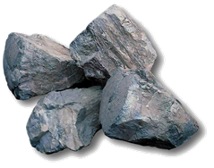
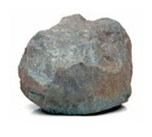

Iron silicate under EU legislation
Iron silicate is a final slag extracted during the copper production
Produced as stones, granules or powders
As final slag, it contains lowest levels of metals and is used in further applications as in concrete, abrasive blasting,river embankement, road constructions….
REACH Regulation sets up rules for putting substances on the European market in volumes higher than 1 ton/year
  Perform risk assessment
  Prove safe use along the substance life cycle
  Present results in a chemical safety report

Slide 4
REACH Dossier in a nutshell
REACH requires to develop risk assessments, based on an increasing level of testing data depending on the volume of the substance to assess
REACH dossiers are based on the following milestones:
Substance Identity
Classification
Hazard Assessment
Exposure Assessment
Risk Assessment
Phys chem – Environmental & Human Health
Substance exposure estimated/measured concentrations
Analytical testing to provide unanbiguous mineralogical composition
Testing strategy or Read Across from structural similar substances
Ratio exposure/hazard threshold < 1

Slide 5
REACH Dossier on Iron Silicate
Iron silicate, as other slags, is an inorganic UVCB (iUVCB): substance of Unknown or Variable composition, Complex reaction products or Biological materials
  It is a complex material typically composed by several metals, metals compounds and minerals with variable concentrations
Challenge: how to comply with REACH requirements for such complex materials?
  In 2012 Eurometaux and its non-ferrous metals consortia launched a project to develop a scientific and pragmatic alternative assessment strategy for iUVCBs

Slide 6
REACH Dossier in a nutshell
REACH requires to develop risk assessments, based on an increasing level of testing data depending on the volume of the substance to assess
REACH dossiers are based on the following milestones:
Substance Identity
Classification
Hazard Assessment
Exposure Assessment
Risk Assessment
iUVCBs Issues:
No PNEC/DNEL available for the UVCB substance due to high variability; No exposures available for the UVCB substance due to complexity
Phys chem – Environmental & Human Health
Substance exposure estimated/measured concentrations
Analytical testing to provide unanbiguous mineralogical composition
Testing strategy or Read Across from structural similar substances
Ratio exposure/hazard threshold < 1

Slide 7
Non-ferrous metals inorganic side products risk assessment approach

Slide 8

Background inorganic UVCBs
Elemental composition is
  known and available
  can present high variability
Speciation/mineralogical composition is:
  can be unknown or uncertain
Complicates toxicity testing: realistic worst-case composition?

Slide 9
Testing approach
Substance Identity
Physico-chemical
endpoints
Substance based
testing approach
Major
constituents
Composition: constituents
Data-poor
Local
toxicological
endpoints
Systemic
toxicological
endpoints
Minor
constituents
Constituent based
testing approach
Ecotoxicological
endpoints
Data-rich

Slide 10
Iron Silicate Risk Assessment

Slide 11
Identification of the Iron Silicate

Slide 12
Classification of the Iron Silicate (1)
  Inorganic UVCB classification is derived following mixture rules
  Variability for each constituent is assessed using their maximum concentration (maximum of Typicals)
  Uncertainty in speciation is tackled assuming worst-case speciation for classification endpoints
TIER 0
Classification of worst case assumption on constituents
TIER 1
Classification based on speciation of constituents
INCREASING KNOWLEDGE
INCREASING CONSERVATISM
TIER 2 Classification based on TDp or Bioaccessibility correction
Releases of metals from the slags are derived using transformation dissolution data
TIER 3 Classification based on measured toxicity response (testing)
www.meclas.eu

Slide 13
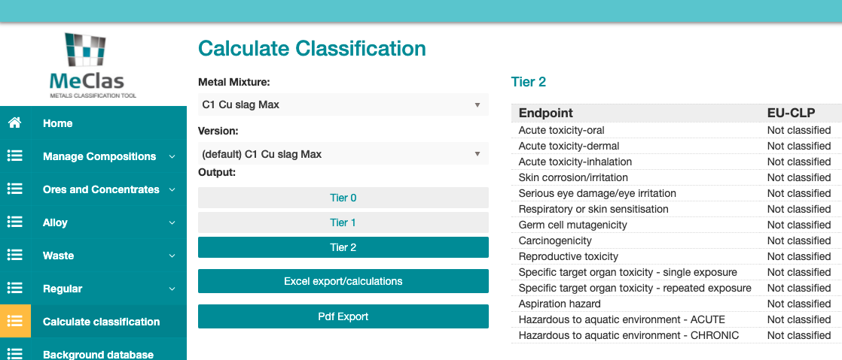
Classification of the Iron Silicate (2)

Slide 14
Hazard Assessment of Iron Silicate
  Substance constituents are assessed:
  in their known speciation or
  in the worst-case speciation for the specific hazard endpoint
  Substance specific testing:
  Bioelution (gastric test)
  Acute toxicity via oral route
  Acute toxicity via dermal route
  Skin and eye irritation
  Bacterial gene mutation test
  Long term outdoor aquatic mesocosm study (freshwater NOEC; Hommen et al, 2012).

Slide 15
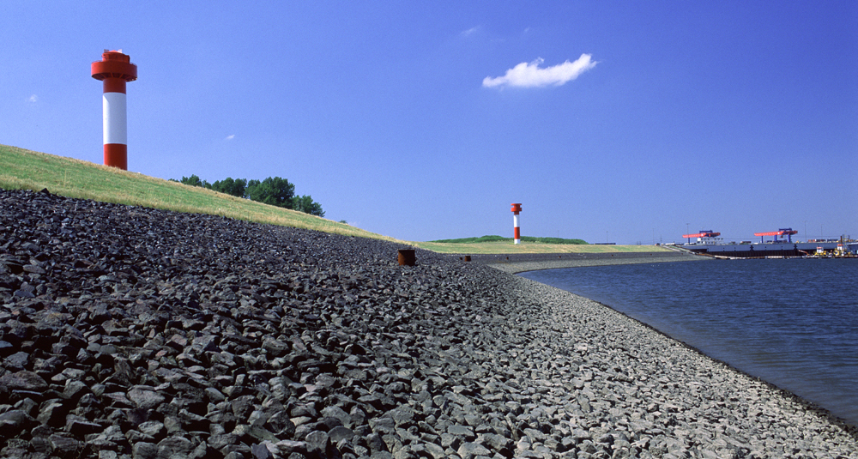
Exposure Assesment of Iron Silicate
Manufacturing
On site assessment of exposure during production includes metal releases related to production of slags & of all associated copper intermediates
Downstream uses
Exposure during final uses is related to metal releases from slags only
Validation for critical use (river embankments) from mesocosm study

Slide 16
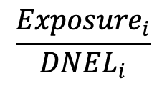

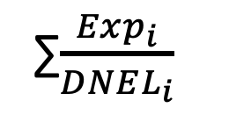
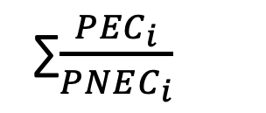
Combined Risk Assessment of Iron Silicate
Risk Characterization Ratio=
Measured metal exposures during production and uses
PNECs/DNELs metals (Cu, Pb, Ni, Zn)
RCR=
$$\frac{{PEC}_{i}}{PNEC_{i}}$$
RCR=
$$\frac{{Exposure}_{i}}{DNEL_{i}}$$
RCR mix=
∑$\frac{{PEC}_{i}}{PNEC_{i}}$
∑$\frac{{Exp}_{i}}{DNEL_{i}}$
< 1
RCR mix=
< 1

Slide 17
Iron Silicate assessment’s conclusions
REACH ‘regular’ Registration Dossiers for complex slags would lead to several difficulties, as:
Validation of the respresentativness of the tested sample
Exposure assessment difficulties
Extended time (costs) for testing
Iron silicate “constituents approach” methodology provides:
A scientific sound and pragmatic risk assessment
Compliance with the European REACH Requirements
Increasing of multi-metallic methodological approach & development of ad hoc tools, as the Eurometaux multimetallic database (MMD)

Slide 18

Thank you!
Wendy Wellens
Violaine Verougstraete
Frederik Verdonck
Koen Oorts

